Slide 1
Securing a Spring Web Application: PART-2
Soham Sengupta

Slide 2
From where we left yesterday
PasswordEncoder –what and why- Example?
Authentication Vs. Authorization
Concept of ROLE and ROLE based access
Enforce HTTPS
Custom User Database service
Securing Views based on ROLE of user
Intercepting requests and filters

Slide 3
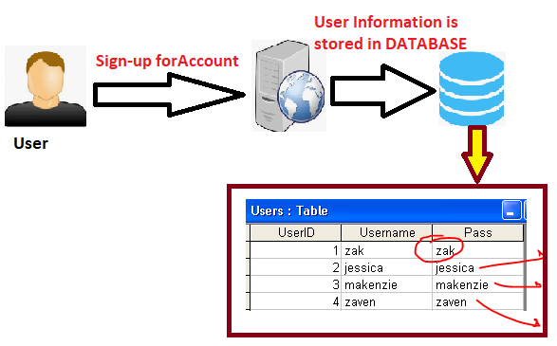

Password Encoder- Why should we avoid saving Password in Plaint-Text
Prying Eye

Slide 4
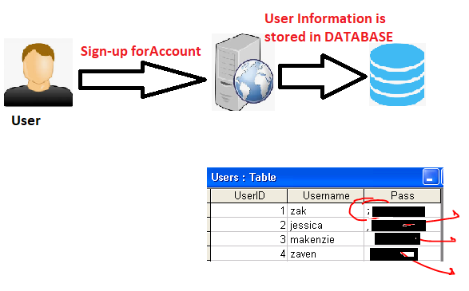
Password Encoder- Remedy- Store it as Cipher (Encrypted ) Text
DON’T store password.
Calculate a value E.g. via any function E.g. f(X) and STORE it
Login module checks if f(PASSWORD) == STORED_VALUE
Prying Eye

Slide 5
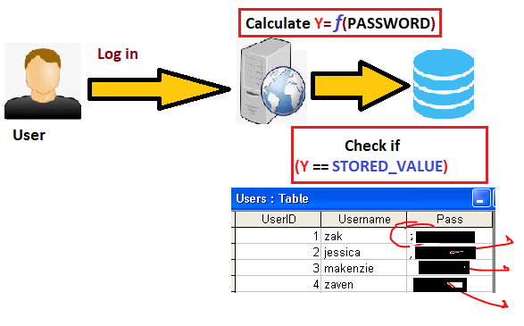

Password Encoder- Remedy- Store it as Cipher (Encrypted ) Text Cont.
Modified Log-in FLOW
Prying Eye
Attempt Login and Fail!

Slide 6
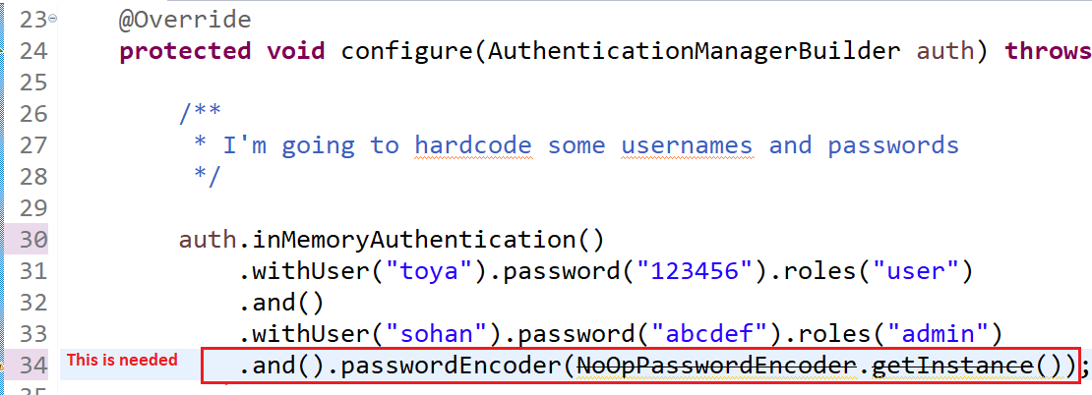
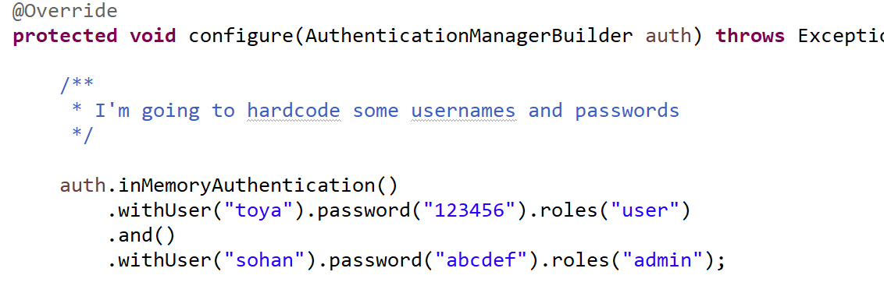
Password Encoder- Remedy- Do it The Spring-way
Spring Security -4.x Vs. Spring-security -5.x
It used to work with Spring Security-4
X It won’t work with Spring Security -5

Slide 7
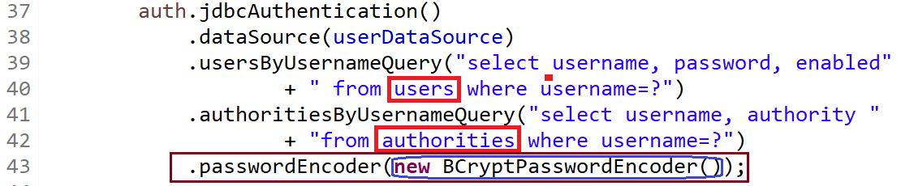
Spring- Password Encoders
NoOpPasswordEncoder (Not Secure & Deprecated)
BCryptPasswordEncoder
Let’s migrate existing code of last day from [1] to [2]

Slide 8
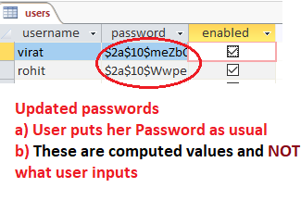
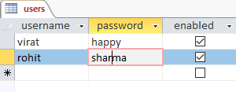
Migrate to BCryptPasswordEncoder
Pick the values of password from existing users
table – where we kept password in plain text
2. We need to keep computed values of passwords here
3. Run a program like this-

Slide 9
Authentication Vs. Authorization
Authentication→ The process of identifying a user across a system
Authorization → The process of checking whether an Authenticated user has the “legal - power” to perform something
Authorization follows Authentication
Getting Authenticated does not ensure Authorization

Slide 10
Concept of ROLE
ROLE is an identifier to decide what a User can do &what she CAN’T
We create a Spring MVC project
JdbcAuthentrication
NoOpPasswordEncoder – to keep it simple and focus on ROLE only.
Let’s assume that we have 2 types of users:
Type-1 : Let’s call them ADMIN- who can access all pages
Type-2 : Let’s call them EMP –who can access requests /emp/**
Both these two types of users can access OPEN pages

Slide 11
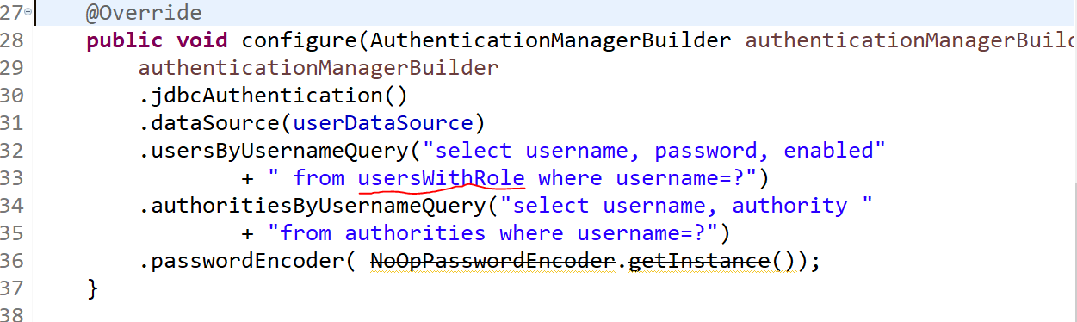
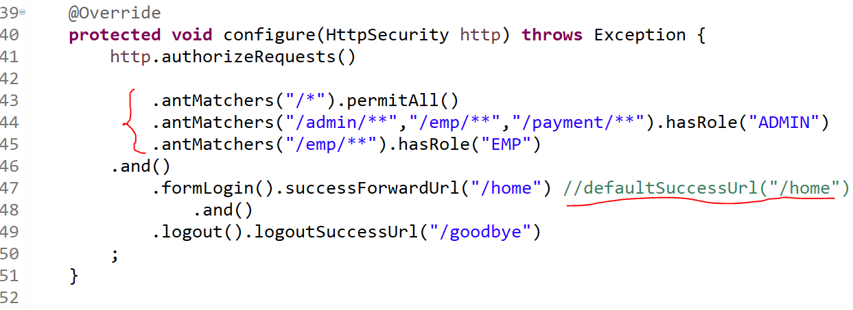
Code Snippet

